Slide 1

IBM Watson – Ecole Polytechnique
The Midnight Team
Report on advances and mock-ups
Ana-Maria CRETU
Jingtao HAN
Jianyang PAN
Baoyang SONG
Mario YNOCENTE CASTRO

Slide 2
Plan
Architecture diagram
Details about each entity
Internal functioning and collaboration between components
Mock-ups

Slide 3
Architecture diagram
Clients
Input their demands for books as a text query
Selecting one of the proposed books ( possible only if the black arrows steps were done)
UI: Web Application using Flask (index.html)
/search
Input is sent to server
Sending the ranked results to the UI
/graph
Query matching and ranking using tf-idf
Exploring the graph beginning from the selected book

Slide 4
Details about each entity of the diagram

Slide 5
UI : client application
Created using Flask
Two possible actions:
  Enter a text query describing what the client would like to read, for example: “I would like to read a science-fiction book, with discoveries and other planets.”
  Select a book among a list of books returned after doing the first action.
Improvements to work on:
  Make it more interactive with the user
  Host it on a server

Slide 6
Query matching and ranking using tf-idf
Done into a .py script, using the most basic approach (tf-idf with the set of reviews as documents).
Improvements to be made:
  Adding the descriptions to the reviews in order to gain a more accurate matching
  Improve the matching technique by extracting keywords from the query and using the keywords extracted from the reviews.

Slide 7
Exploring the graph beginning from the selected book
Created using D3.js de Javascript.
Functionalities:
  Visualize all books (as nodes) in a graph interface. Books are linked by edges if they are considered similar enough
  Click on a node and see the information about the corresponding book.
Improvements to be made: add the information about the edges (similarity coefficient), add more features when displaying information about a book.

Slide 8
Internal functioning and collaboration between components
Data collection
Data storage
Computing the similarity matrix

Slide 9
Data collection
Data fetched from www.goodreads.com using Goodreads API and a parsed .py script. The scrawling is done recursively (depth of 2) by adding a book together with its similar books (according to the API).
Stored locally in “id.json” files, where id = the id of the book assigned by the API.
Whenever we compute the result of the query or updating the similarity matrix, we are fetching the reviews / description / book information by opening these files.
Improvements:
  For each book, filtering the reviews in order to fetch only those written in English (because of poor results when extracting keywords and computing the similarity between the books). We would like to use a language detector for each review. 6k books * 100 reviews ≈ 600k calls to Alchemy API.

Slide 10
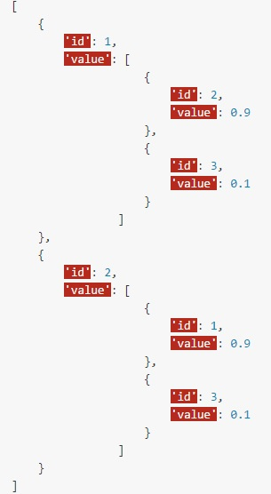
Data storage
Books’ data stored locally in .json.
The similarity matrix between books is stored in a .json file having the below displayed format: each edge (id, value) with value storing the ids of the books it links and the values of the coeffs. This storage is a bit redundant (each edge appears twice) but is more easy to manipulate.
Potential improvements: store the books (id.json) and the similarity matrix in a database, maybe MySQL.

Slide 11
Computing the similarity matrix
We use the tf-idf technique (in Python with the the scikit-learn package)
We build 2 similarity matrices of the same size:
  first matrix, using the entire set of reviews of a given book as the document and all the keywords (extracted with Alchemy) as a vocabulary (http://scikit-learn.org/stable/modules/generated/sklearn.feature_extraction.text.TfidfVectorizer.html)
  Second matrix, using a book’s description as the document.
  Then we compute a weighted mean of these matrices, giving more weight to the reviews.
Improvements to be made:
  Find good coefficients (we use 5 and 2 and it seems accurate).
  Integrate another feature in the similarity computation : the “shelves” tags from the users, as vectors.

Slide 12
Mock-ups

Slide 13
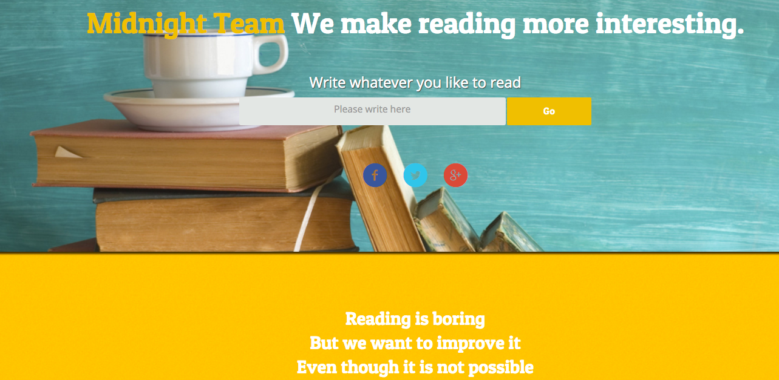

Slide 14
Writing a query expressing what we would like to read. Our example : “harry”
Results appear (top 10 relevant results)…

Slide 15
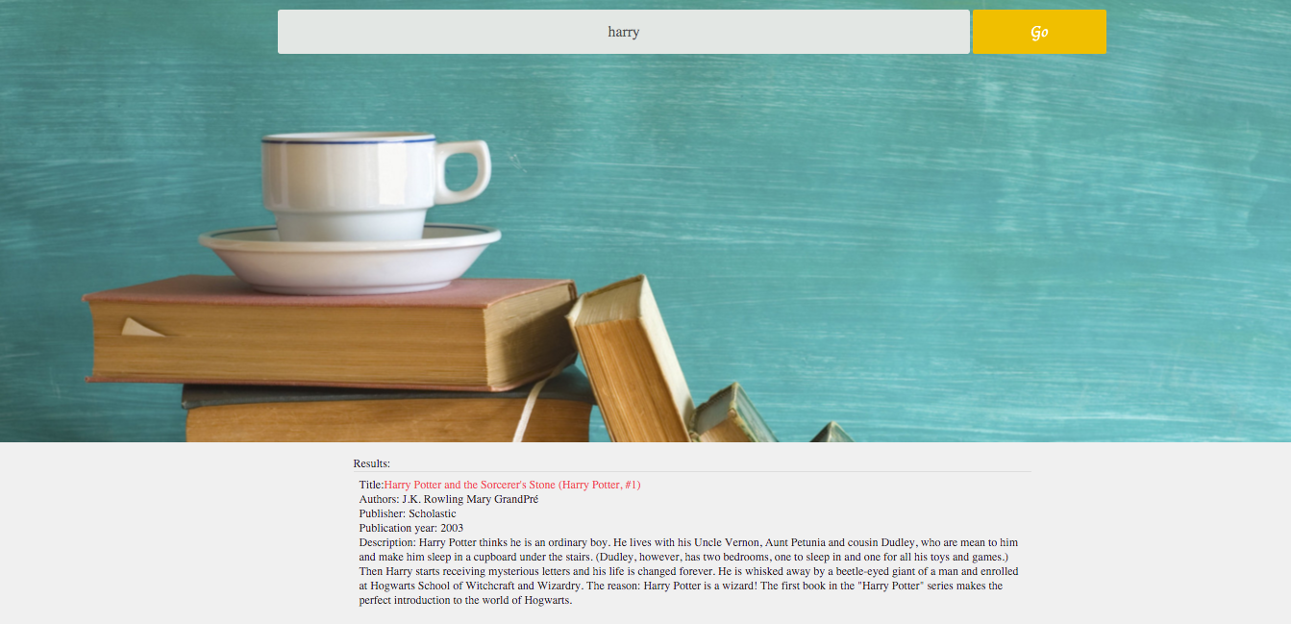

Slide 16
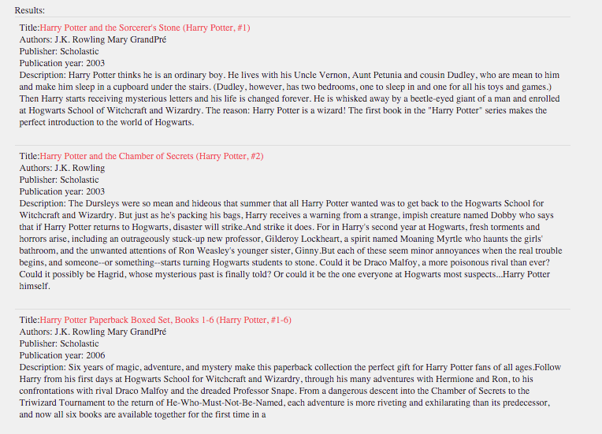

Slide 17
Clicking on the first result in order to enter the graph webpage

Slide 18
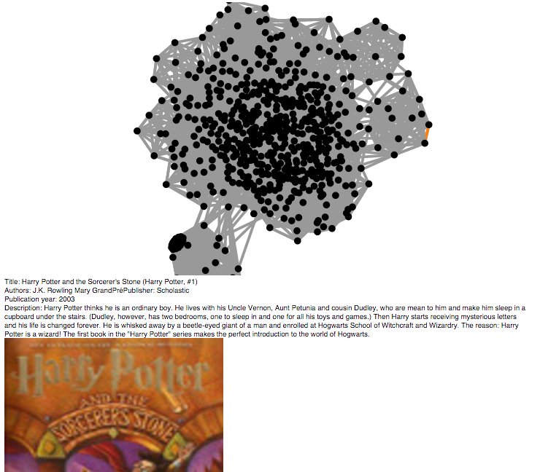
We click on this edge to navigate to an adjacent book

Slide 19
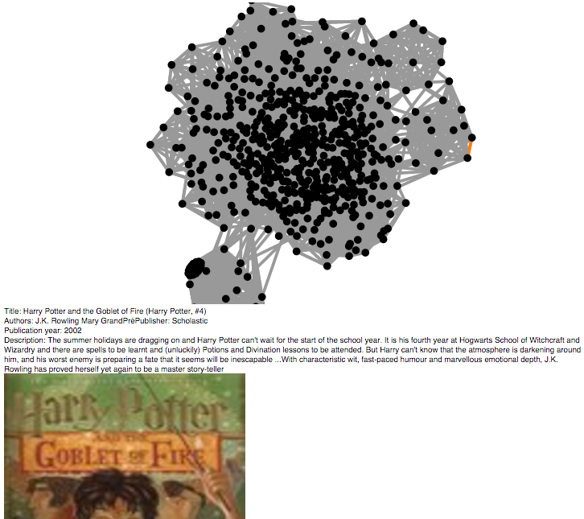

Slide 20
The user can go on navigating through books according to their similarity…
That’s it for now! To be continued…

